Slide 1
Asking advice on your relationships
(The use of active learning for relation extraction)
03/11/2021
Charlotte Nachtegael, ULB
Promoter : Pr. Tom Lenaerts
RCA : Sirris
[FR] Soutenu par le Service public de Wallonie - Recherche (Convention de recherche n° 2010235 « ARIAC BY DIGITALWALLONIA4.AI »).
[EN] Supported by Service public de Wallonie – Recherche under grant n°2010235 « ARIAC BY DIGITALWALLONIA4.AI »

Slide 2
WHAT IS ACTIVE LEARNING ?
Dataset
Labelled
instances
TRAINING
PREDICT
Unlabelled instances
MODEL
Predicted instances
USER LABELLING
QUERY SELECTION
ORACLE

Slide 3
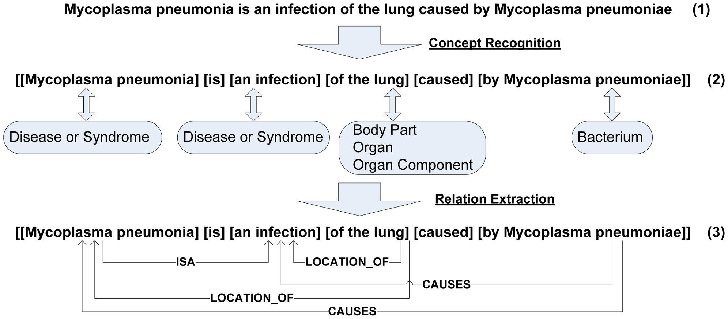
USE CASE : RELATION EXTRACTION

Slide 4
USE CASE : RELATION EXTRACTION
{Person, (mutation)*n, disease}

