Slide 1
Deep Learning in Digital Pathology
Adrien Foucart
November 3rd, 2021
Notes:
In this presentation, I’d like to talk a bit about the « ground truth » that we use to train and test deep learning algorithms, in the context of digital pathology.

Slide 2
https://analogintelligence.com/artificial-intelligence-ai-startups-pathology-venture-meta-review-analysis/

Slide 3
Sample acquisition
Supervised dataset
Samples
Annotations
Deep Learning
Model fitting
Model use

Slide 4
Dataset
Characteristics of an "ideal" dataset?
Large amount of diversified samples
High-quality images
High-quality annotations ("Ground Truth")
Well-defined task
$$X_{i}$$
$$X_{i}$$
$$X_{i}$$
$$X_{i}$$
$$X_{i}$$
$$Y_{i}$$
Characteristics of a digital pathology dataset?
Very large images, but low quantity / diversity
Acquisition / manipulation / staining artefacts
Annotation process is slow, no ground truth
"Deep learning" task != desired clinical output

Slide 5
What can we do about it?
Data augmentation
Learning strategies
Adapted evaluation

Slide 6
What can we do about it?
Data augmentation
Affine / elastic transforms
Colour space transforms
Scale
Noise
Blur
GANs
…
Learning strategies
Adapted evaluation
Y-R. Van Eycke, A. Foucart and C. Decaestecker, 2019, Frontiers in Medicine

Slide 7
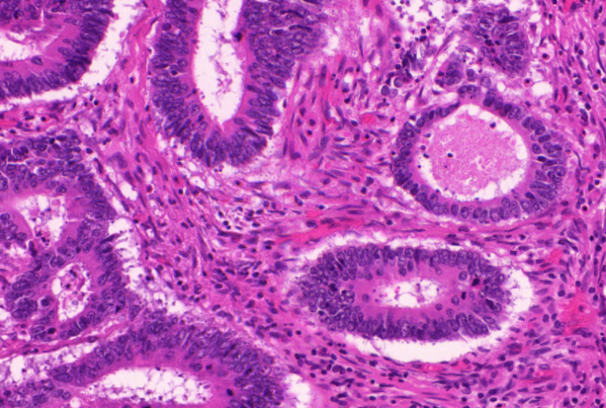
What can we do about it?
Data augmentation
Semi-supervised
Noisy
Weak
The quantity of supervised samples is less than the total quantity of samples.
The accuracy of the supervision is not guaranteed.
The precision of the supervision is lower than the precision of the target
Learning strategies
Adapted evaluation
?
X
Auto-encoder + transfer learning…
Noise modeling, error detection, reinforced learning…
Multiple Instance Learning, heatmaps…
A. Foucart, O. Debeir and C. Decaestecker, 2019, ISBI 2019

Slide 8
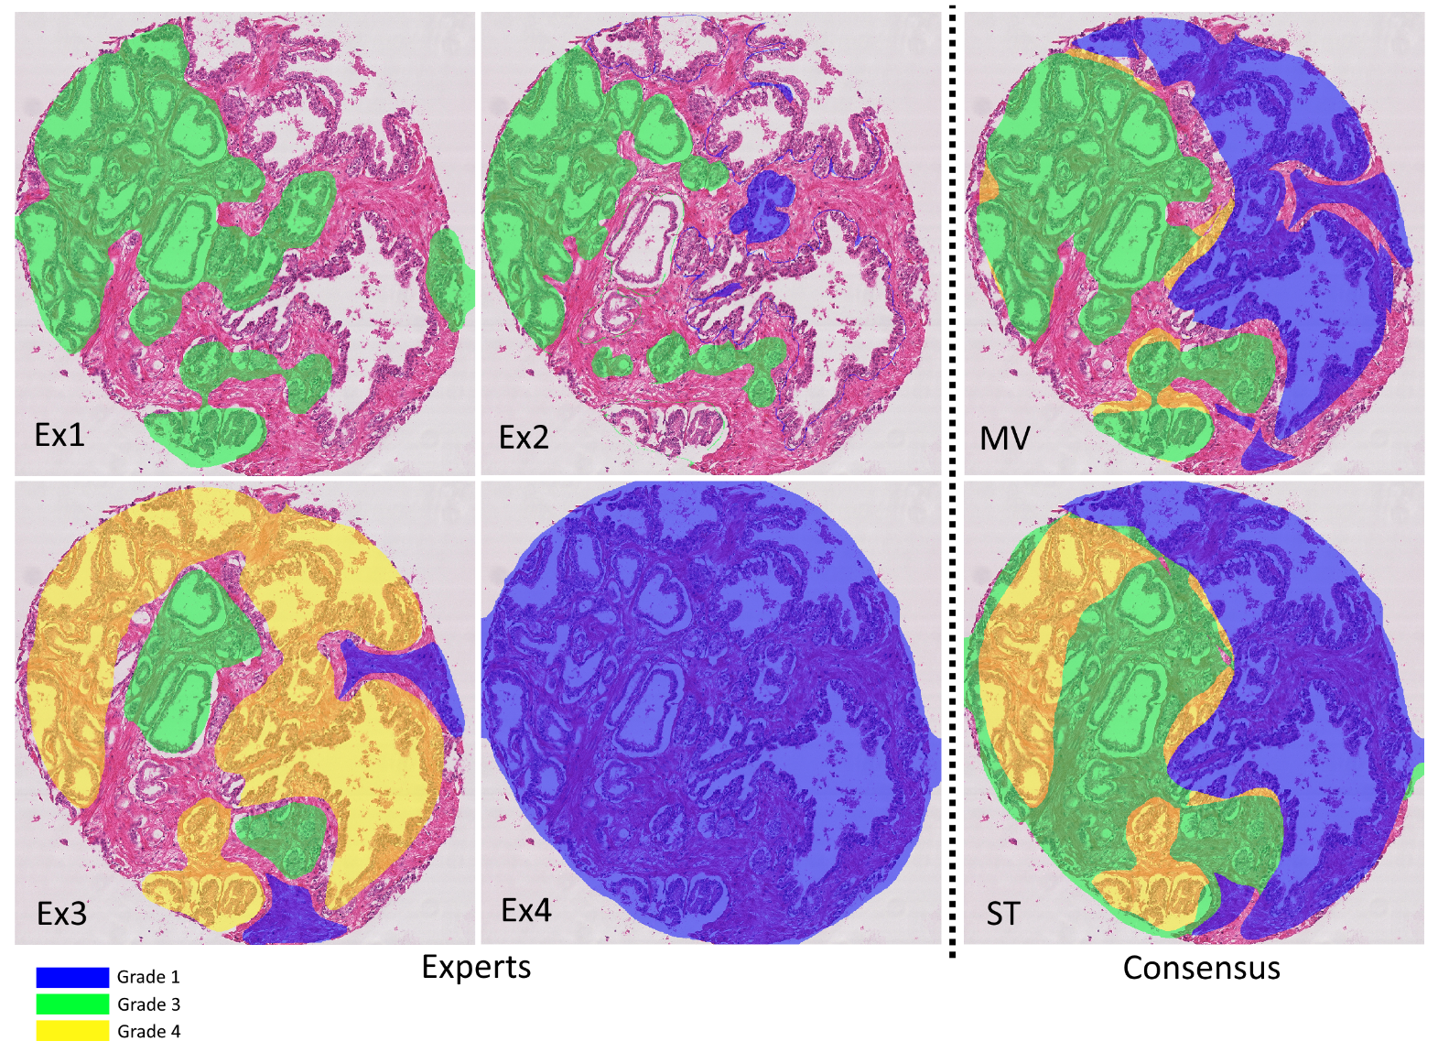
What can we do about it?
Data augmentation
Learning strategies
Adapted evaluation
A. Foucart, O. Debeir and C. Decaestecker, 2021, SIPAIM 2021

Slide 9
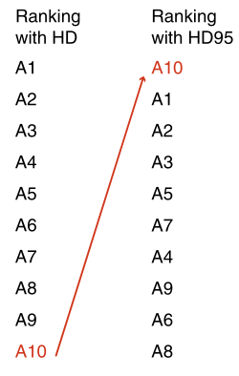
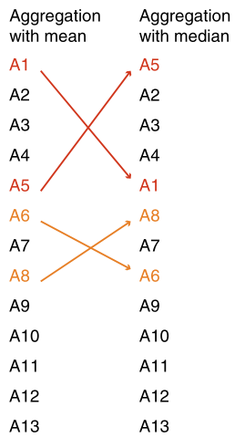
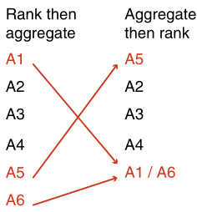
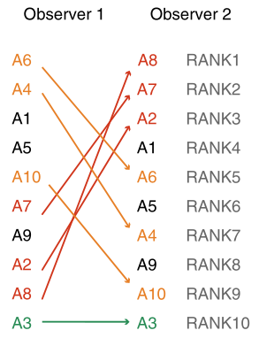
What can we do about it?
Data augmentation
Avoid biased metrics (e.g. per-pixel F1-score for segmentation).
Multiple independent metrics > single "summary" metric.
If multiple experts available: metrics computed vs each expert separately.
Always take into account inter-expert disagreement ("is my method as much in agreement with the supervision as other human experts would be?").
Make sure the metric fits the task (e.g.: if the shape is very important, Hausdorff Distance > IoU for segmentation).
Beware of rankings!
Learning strategies
Adapted evaluation
L. Maier-Hein et al, 2018, Nature Communications

Slide 10
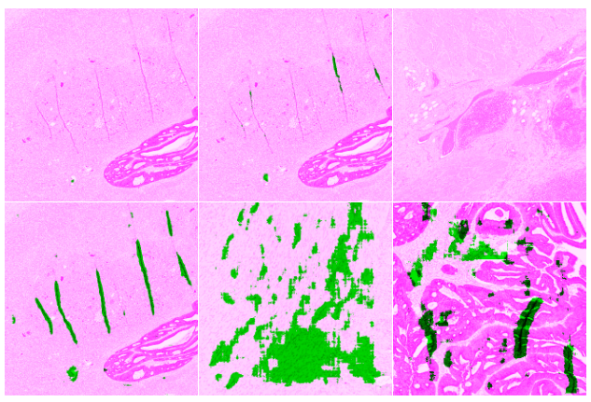
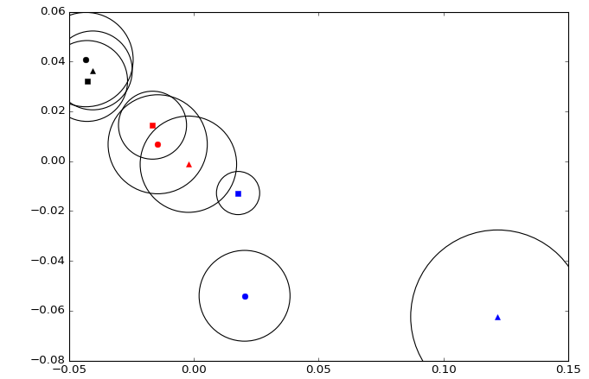
Example: Artefact segmentation
Comparison between 3 learning strategies (Baseline, Only Positives, GA) for 3 different networks (ShortRes, PAN, U-Net).
No expert annotation.
Qualitative-quantitative evaluation: looking at results from 21 test tiles, manually grade each result as « Good », « Bad », « False Positive » or « False Negative »)
Scoring system = penalty score -> lower = better
Similarity – MDS viz.
Scores | Baseline | OnlyP | GA50
Shortres ◻ | 16 | 10 | 9
PAN ○ | 19 | 15 | 4
U-Net ∆ | 18 | 34 | 3
A. Foucart, O. Debeir and C. Decaestecker, 2020, preprint

Slide 11
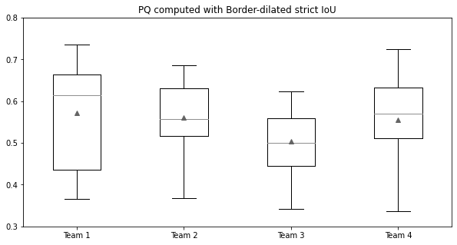
Example: Nuclei segmentation, detection and classification
MoNuSAC challenge metric: "Panoptic Quality"
Avg PQ
0,572
0,561
0,504
0,555
A. Foucart, O. Debeir and C. Decaestecker, 2021, preprint

Slide 12
Example: Nuclei segmentation, detection and classification
Disentangled metrics:
Detection F1-score, precision, recall
Classification NCM, accuracy, per-class P/R/F1
Segmentation IoU, HD
 | Team 1 | Team 2 | Team 3 | Team 4
Team 1 |  | No significant difference | > Detect. > Seg. | < Seg.
Team 2 | No significant difference |  | > Detect. > Seg. | > Class. < Seg.
Team 3 | < Detect. < Seg. | < Detect. < Seg. |  | < Detect. < Seg.
Team 4 | > Seg. | < Class. > Seg. | > Detect. > Seg.
A. Foucart, O. Debeir and C. Decaestecker, 2021, preprint

Slide 13
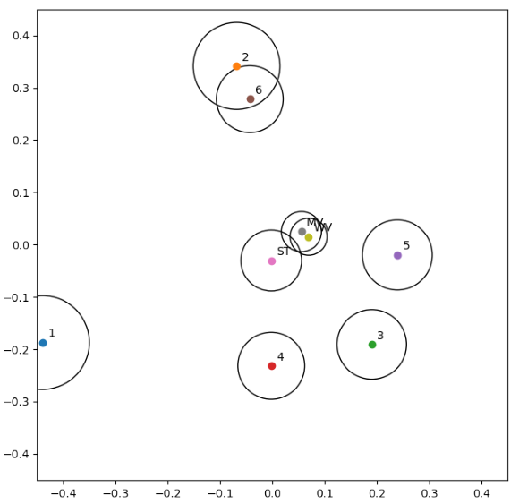
Example: Prostate grading
A. Foucart, O. Debeir and C. Decaestecker, 2021, Proc. SIPAIM 2021

Slide 14
Deep Learning in Digital Pathology
Sample acquisition
Artefacts, selection bias, hardware bias…
Supervised dataset
Quality/Quantity of annotations, inter-expert disagreement…
Samples
Annotations
Deep Learning
Inter-expert disagreement, learning strategies, adapted evaluation…
Model fitting
Model use

Slide 15
?

